Slide 1
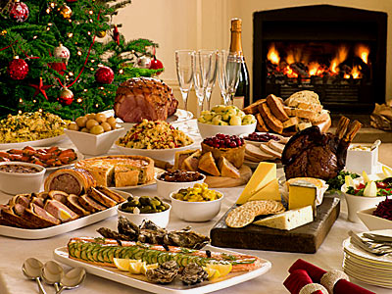
Festival of Food

Slide 2
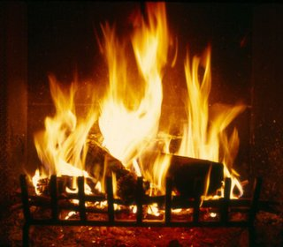
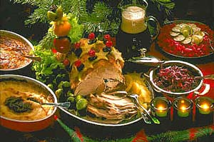
Yule
Cookies and cakes, fruits, nuts, pork dishes, turkey, eggnog, ginger tea, spiced cider, ale, heavy meat dishes, sugar, nutmeg, roasted apples.

Slide 3
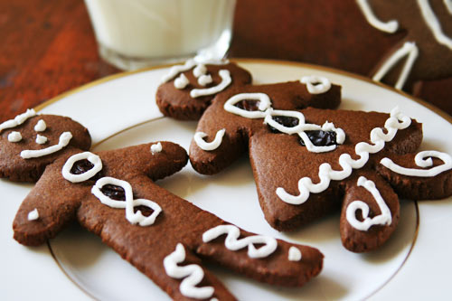
Gingerbread Men Cookies
Ingredients:
2 1/2 cups all-purpose flour
1 teaspoon baking powder
1/4 teaspoon baking soda
1/4 teaspoon salt
1 teaspoon ground cinnamon
1 teaspoon ground ginger
1 teaspoon ground cloves
1/4 teaspoon ground allspice
1 egg
1 cup firmly packed brown sugar
2/3 cup dark molasses
6 tablespoons softened butter
Raisins for decoration
Instructions:
Sift together all the dry ingredients (everything in the ingredient list up to the allspice), and mix them up. Then, in a separate bowl, beat together the wet ingredients (everything from the egg to the butter). Once the second mixture is beaten uniformly, add the dry ingredients little by little to the wet mix, stirring until well-blended. Cover the mixture and refrigerate it for one hour. Preheat the oven to 350º F. Sift some flour onto a board and the rolling pin to avoid having the dough stick, and roll out a portion of the dough onto the board, down to 1/4-inch thickness. Use a 2-inch cookie cutter shaped like a man to cut out cookies, and place them onto a buttered cookie sheet, one inch apart. (Or you can make the men yourself using just your hands, pressing the shape out how you like.) Decorate the cookies with raisins for eyes, nose, mouth, and buttons, if you desire. Bake them for 8 minutes, or until firm. Cool on a wire rack. Note: If you'd rather not use raisins, you can always use frosting or another form of decoration to make these into gingerbread men, OR if you'd rather just have gingerbread (without making them "men"), you can just bake squares of it the same way.
Yield: About 50 cookies

Slide 4
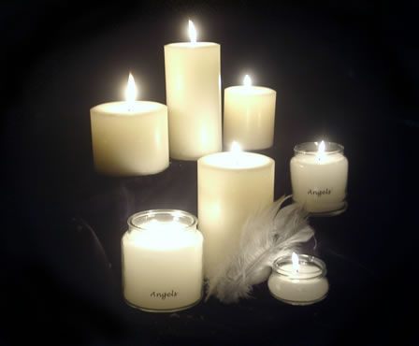
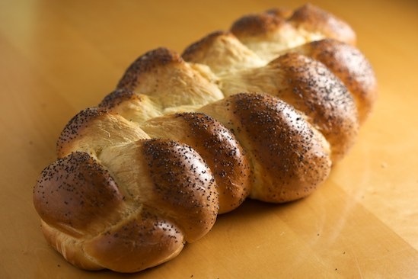
Imbolc
Pumpkin seeds, Sunflower seeds, Poppy seed Cakes, muffins, scones, and breads products, peppers, onions, garlic, raisins, spiced wines and Herbal Teas. Bread, traditional braided bread, milk and all dairy, corn and clover.

Slide 5
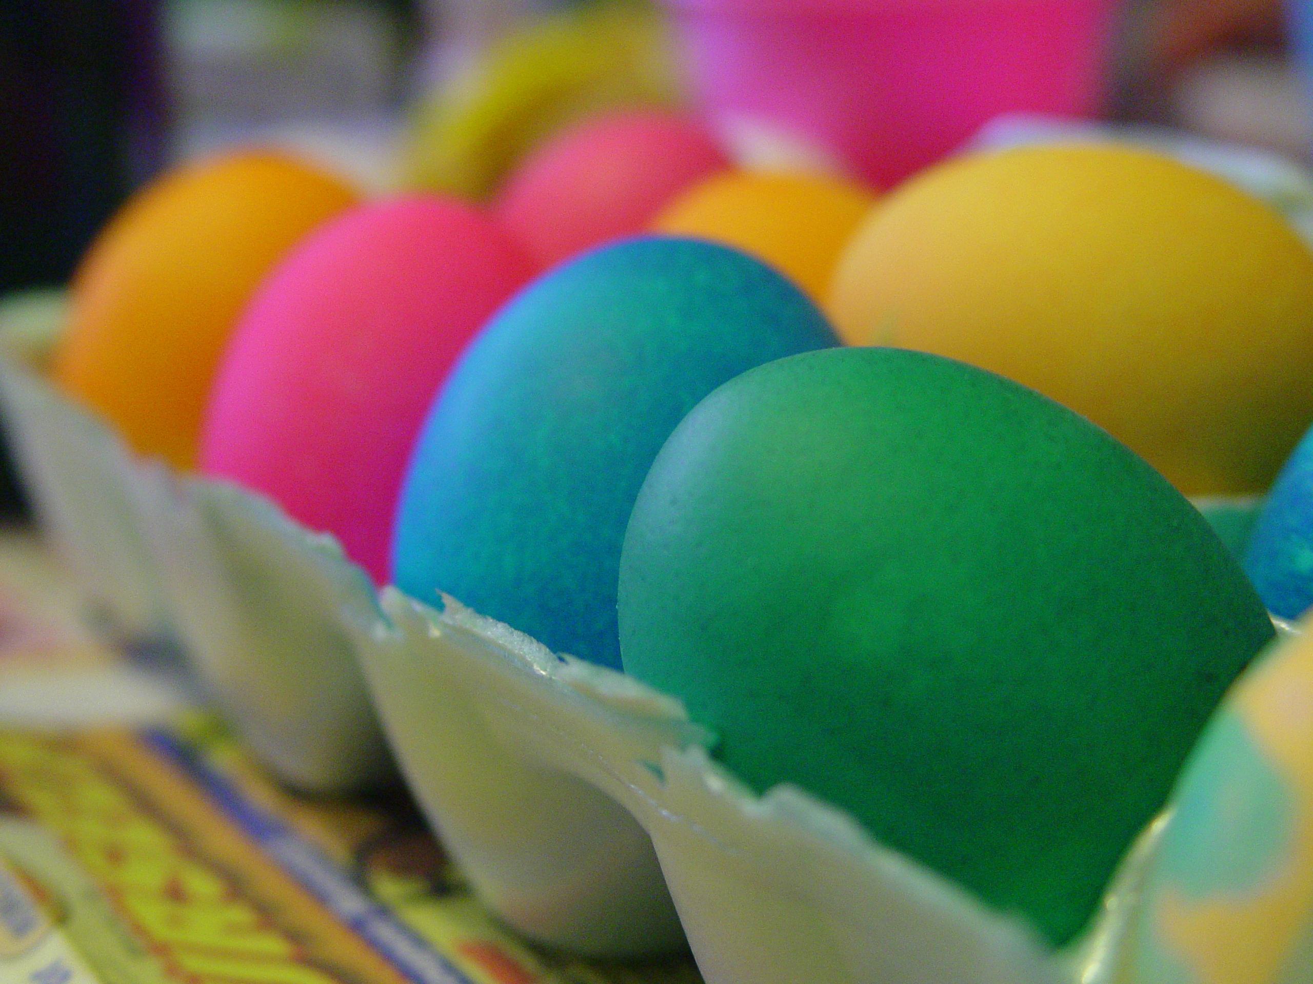
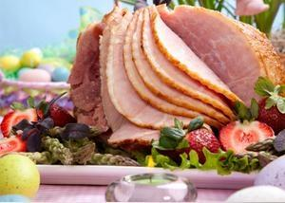
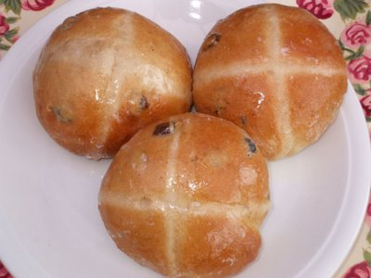
Ostara
Leafy green vegetables, Dairy foods, Sunflower and Pine. Flower Dishes and Sprouts. Eggs, hot cross buns and ham.

Slide 6
May Day Maple Hearth Bread
1 envelope active dry yeast 1/3 cup real maple syrup ¼ cup warm water (105ºF-115ºF) 3 cups flour 3 tablespoons packed brown sugar 1 tablespoon baking powder ½ teaspoon salt ¼ cup shortening Directions: Dissolve yeast in the water. Mix 1 ½ cups of the flour with the brown sugar, baking powder, and salt. Cut in shortening. Dissolve the syrup into the yeast mix too. Add yeast mix to the flour mix; stir. Add flour until dough is easy to handle. Turn onto a floured surface and knead for 1 minute. Cover and let rise for 15 minutes. Form into round, place on cookie sheet. Let rise in a warm spot for 30 minutes.

Slide 7
Litha
Garden fresh fruits and vegetable
Bright Memories Parfait 1 23/4 oz package vanilla custard mix (no bake type) 1/2 tsp. vanilla 2 cups milk 1 1lb 5oz can pineapple pie filling 2 3oz packages cream cheese, softened
In sauce pan prepare custard according to the package directions using the milk. Remove from heat. Gradually stir cheese into hot mixture, mixing well. Stir in vanilla. Chill custard mixture and pie filling separately until ready to serve. When ready to serve, spoon alternate layers of mixture and pie filling into parfait or juice glasses. Top with some type of berries if desired.

Slide 8
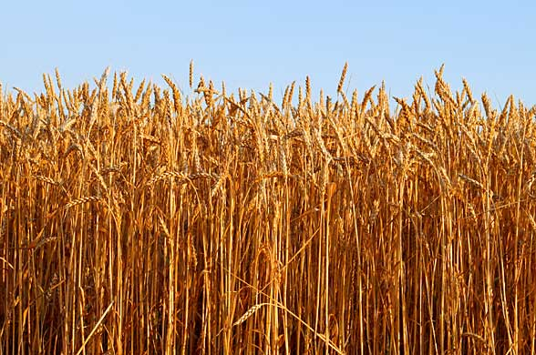
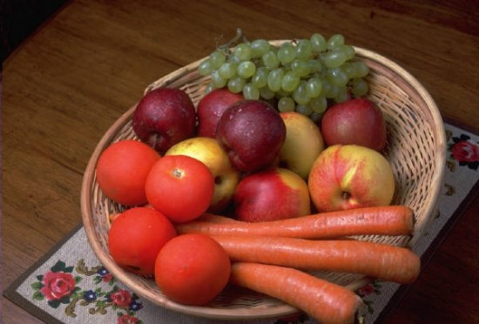
Lughnasadh / Lammas
Apples, Grains, Breads, Berries, and other harvest foods.

Slide 9
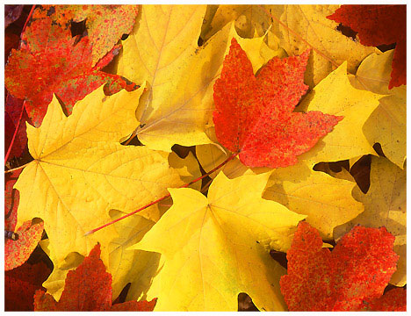
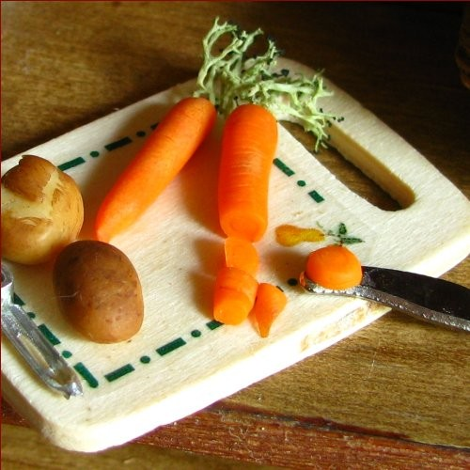
Mabon
Breads, nuts, apples, pomegranates, and vegetables such as potatoes, carrots, and onions

Slide 10
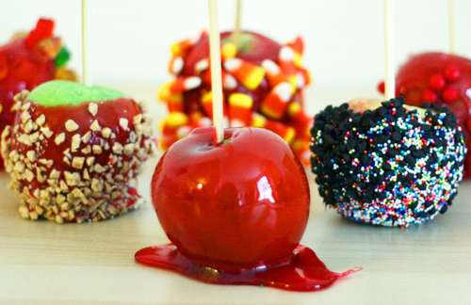
Samhain
Turnips, apples, pumpkin and other gourds, nuts, mulled Wines, beef, pork, poultry. pumpkin

Slide 11
Pumpkin Spice Latte
makes 1-2 servings
Ingredients: 2 cups milk 2 tablespoons canned pumpkin OR 1 teaspoon of Torani Pumpkin Spice Syrup (your choice) 2 tablespoons sugar or sugar substitute - you can halve this amount 2 tablespoons vanilla extract 1/2 teaspoon pumpkin pie spice 1-2 shots espresso (about 1/4 cup of espresso or 1/2 cup of strong brewed coffee if you don't have an espresso machine.)
Directions: In a saucepan combine milk, pumpkin and sugar and cook on medium heat, stirring, until steaming. Remove from heat, stir in vanilla and spice, transfer to a blender and process for 15 seconds until foamy. If you don't have a blender, don't worry about it - just whisk the mixture really well with a wire whisk.
Pour into a large mug or two mugs. Add the espresso on top.
Optional: Top with whipped cream and sprinkle pumpkin pie spice, nutmeg, or cinnamon on top.
Magical Properties of Pumpkin:
Pumpkins cooked, or pumpkin seeds are known to attract money and when paired with cinnamon, nutmeg and ginger will give it an added *oomph!*

Slide 12
Herbs
Basil- This wonderful robust herb is attributed to a variety of magical uses such as consecration, divination, exorcism, fertility, fidelity, luck, happiness, harmony, love to just name a few. Basil is bound to the planet Mars and the element Fire.
Bay Leaves- The Bay leaf is the leaf of two types of trees, the sweet bay tree and the laurel tree. Bay leaves are one of those herbs that should adorn every witch and non-witches' cupboards for it's fantastic flavor in soups and sauces. It's magical properties include wisdom, clairvoyance, protection and psychic power. Bay leaves are also used in aiding healing and purification. Bay leaves are also known to keep moths away and keeping your clothing and linens fresh.
Chamomile- Being a medicinal herb, the volatile oils are an anti-spasmodic which is used in treating indigestion as well as menstrual cramps and other common stomach ailments. Also known as an anti-inflammatory and anti-infective, chamomile is great for treating minor skin disorders. Let's not forget the wonders of having a cup of hot chamomile tea to ensure a good night's rest.

Slide 13
Sick Times
Cough Syrup
2 Cups Water
1 Teaspoon Chamomile
2 Teaspoons Liquorice Root
2 Teaspoons Cherry Bark
1 Teaspoon Thyme
1 Teaspoon Ginger
3 Cloves
1 Star Anise
1 Cup Sugar or Honey
Lemon Juice
Bring the herbs and water to a boil while mixing. Place th lid on the pot and let simmer for 20 minutes. Strain away the herbs and add the sugar. Bring to a simmer and allow to reduce and form a syrup. Add lemon juice to taste and stir. Remove from heat and pour into a jar.

Slide 14
For more recipes for special occasions: http://recipes.swankivy.com/precipes.html

